Slide 1

TypeScript
Tahaluf Training Center 2021

Slide 2
Day 02
1
If Condition
2
Switch Statements
3
Loops (For, While)
4
Object
5
Array
6
Arrow Function

Slide 3
IF Condition
An if statement can include one or more expressions which return boolean. If the boolean expression evaluates to true, a set of statements is then executed.

Slide 4
IF Condition
Example:
if (true)
{
console.log('This will always executed if the is true.');
}
if (false) {
console.log('This will never executed becoue the condition is false.');
}

Slide 5
IF Condition
In this example, the if condition expression num1 < num2 is evaluated to true and so it executes the statement within the curly { } brackets.

Slide 6
IF Condition
Example :
let num1: number = 10, num2 = 20;
if (x < y)
{
console.log(‘num1 is less than num2’);
}

Slide 7
IF Condition
An if else condition incorporates two squares - if block and an else block. Assuming the if condition assesses to the true, the in case block is executed. Something else, the else block is executed .

Slide 8
If else condition
Example:
let num1: number = 10, num1 = 20;
if (num1 > num2)
{ console.log(‘num1 is greater than num2.');
}
else
{ console.log(‘num1 is less than or equal to num2.’)
; //This statement will never be executed
}

Slide 9
Else if condition
let num1: number = 10, num2 = 20;
if (num1 > num2)
{
console.log(‘num1 is greater than num2.');
}
else if (num1 < num2)
{
console.log(‘num1 is less than num2.'); //This will be executed
}
else if (num1 == num2)
{
console.log(‘num1 is equal to num2');
}

Slide 10
Day 02
1
If Condition
2
Switch Statements
3
Loops (For, While)
4
Object
5
Array
6
Arrow Function

Slide 11
Switch statement
A switch statement has one block of code corresponding to each value and can have any number of such blocks. When the match to a value is found, the corresponding block of code is executed.

Slide 12
Switch statement
Example:
switch(expression) {
case constant-expression1: {
//statements;
break;
}
case constant_expression2: {
//statements;
break;
}
default: {
//statements;
break;
} }

Slide 13
Switch statement
The switch statement can include constant or variable expression which can return a value of any data type.
There can be any number of case statements within a switch. The case can include a constant or an expression.

Slide 14
Switch statement
We must use break keyword at the end of each case block to stop the execution of the case block.
The return type of the switch expression and case expression must match.
The default block is optional.

Slide 15
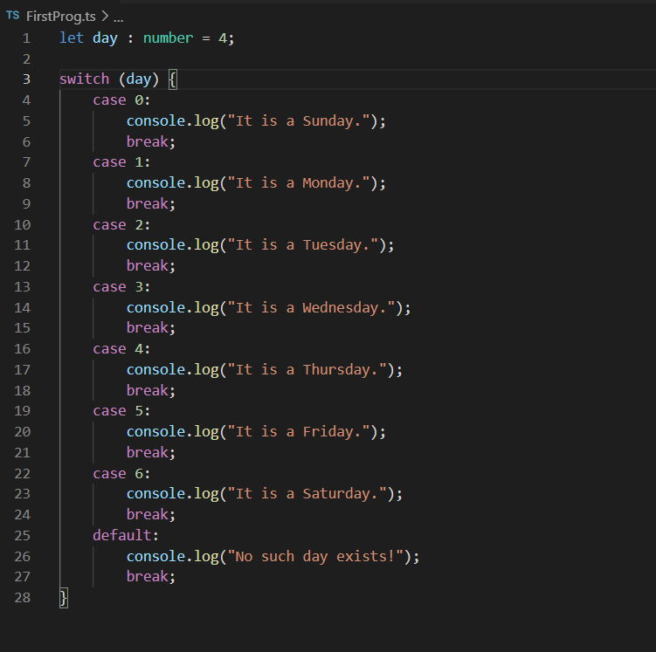
Demo

Slide 16
Day 02
1
If Condition
2
Switch Statements
3
Loops (For, While)
4
Object
5
Array
6
Arrow Function

Slide 17
For Loop
The for loop is used to execute a block of code a given number of times, which is specified by a condition.

Slide 18
For Loop
Example: for (let i = 0; i < 3; i++) {
console.log ("Block statement execution no." + i);
}
Output: Block statement execution no.0
Block statement execution no.1
Block statement execution no.2

Slide 19
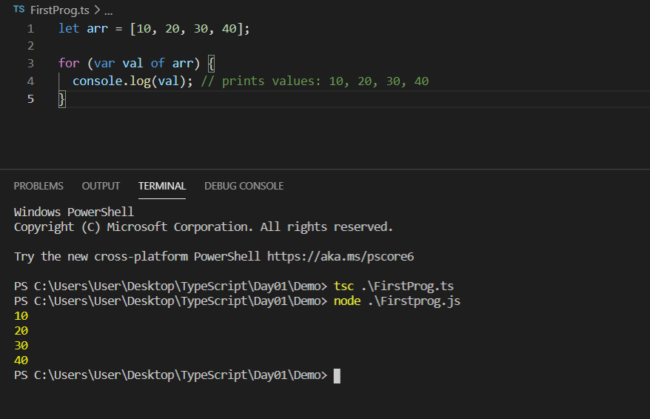
For Loop

Slide 20
While Loop
The while loop is another type of loop that checks for a specified condition before beginning to execute the block of statements. The loop runs until the condition value is met.

Slide 21
Example:
let i: number = 2;
while (i < 4) {
console.log( "Block statement execution no." + i )
i++; }

Slide 22
do. While loop
The do..while loop is similar to the while loop, except that the condition is given at the end of the loop. The do..while loop runs the block of code at least once before checking for the specified condition. For the rest of the iterations, it runs the block of code only if the specified condition is met.

Slide 23
do. While loop
Example:
let i: number = 2;
do {
console.log("Block statement execution no." + i )
i++;
} while ( i < 4)

Slide 24
Day 02
1
If Condition
2
Switch Statements
3
Loops (For, While)
4
Object
5
Array
6
Arrow Function

Slide 25
Object
An object is an instance which contains set of key value pairs.
Syntax:
var object_name = {
key1: “value1”, //scalar value
key2: “value”,
key3: function() {
//functions
},
key4:[“content1”, “content2”] //collection
};

Slide 26
Object
Example :
const employee: any = {
name: 'Ahmad',
age: 30,
department: 'web Development',
section: 1
}

Slide 27
Object
You can edit to the constant object using the name of the properties .
Example :
employee.name = 'Dana’;
And you can add a new properties for a constant object
Example :
employee.address = 'Jordan/Irbid '

Slide 28
Day 02
1
If Condition
2
Switch Statements
3
Loops (For, While)
4
Object
5
Array
6
Arrow Function

Slide 29
Array
An array is a special type of data type which can store multiple values of different data types sequentially.
Syntax :
const , var, let Array_Name: DataType[] =[values]

Slide 30
Array
To add to the constant array you can use push method .
Example
const nameArray: string[] = ['name1’, 'name2', 'name3', 'name4']
nameArray.push('name5');
nameArray.push('name6');
Filevalidation = () => {

Slide 31
Array
To change a specific value for constant array :
Syntax :
Array_name[Index] = newValue;
Example :
nameArray[0] = 'name6';

Slide 32
Array
There are two ways to declare an array:
1. Using square brackets.
This method is similar to how you would declare arrays in JavaScript.
let names: string[] = [‘Dana', ‘Kanaan’];
Using a generic array type, Array<elementType>. let names: Array<string> = [‘Dana', ‘Kanaan'];

Slide 33
Array
spread operator:
The main objective of the spread operator is to spread the elements of an array or object. This is best explained with examples.

Slide 34
Array
const sport: string[] = ['Basket ball', 'Tennis', 'Football', 'soccer']
const fightingSports: string[] = ['MMA', 'Kung Fu'];
const allSports = [...sport, ...fightingSports];
console.log(allSports);

Slide 35
Array
You can add to spread operator:
const sport: string[] = ['Basket ball', 'Tennis', 'Football', 'soccer']
const fightingSports: string[] = ['MMA', 'Kung Fu'];
const allSports = ['AnotherSport3', ...sport, 'AnotherSport4', ...fightingSports, 'AnotherSport5'];
console.log(allSports);

Slide 36
Array
Distructuring : Swap two variables without using a third one
Note that array destructuring is effectively the compiler doing the [0], [1], ...

Slide 37
Array
Example:
const sport: string[] = ['Basket ball', 'Tennis', 'Football', 'soccer']
const [top1, top2] = sport;
console.log(top1, top2)//Basket ball,Tennis

Slide 38
Array
Example:
const sport: string[] = ['Basket ball', 'Tennis', 'Football', 'soccer']
const [top1, top2, ...otherSports] = sport;
console.log(top1, top2);
console.log(otherSports);

Slide 39
Exercise
Sreach about Distructuring in the object

Slide 40
Day 02
1
If Condition
2
Switch Statements
3
Loops (For, While)
4
Object
5
Array
6
Arrow Function

Slide 41
Arrow Function
Syntax
const FunctionName =
(Parameters) => {//Body of the function};

Slide 42
Arrow Function
Example :
const addNumbers =
(num1: number, num2: number) => num1 + num2;
const sum = addNumbers(5, 6);
console.log(sum);

Slide 43
Arrow Function
type MyFunctionTypes = (() => void) | string
const getMyPrinter = (printType: string, n1: string, n2: string): MyFunctionTypes => {
if (printType == 'fullName') {
return () => {
return console.log(`${n1} ${n2}`)
};
}

Slide 44
Arrow Function
else if (printType == 'comma') {
return () => { return console.log(`${n1}, ${n2}`) }
}
else {
return n1 + n2;
}
}

Slide 45
Arrow Function
const printFun = getMyPrinter('fullName', 'Angular', 'Typescript');
const printFun2 = getMyPrinter('comma', 'Angular', 'Typescript');
const printFun3 = getMyPrinter('SomethingElse', 'Angular', 'Typescript');

Slide 46
Arrow Function
const printFormPrinter = (myPrinter: MyFunctionTypes) => (typeof myPrinter == 'string') ?
console.log(myPrinter) : myPrinter();
printFormPrinter(printFun);
printFormPrinter(printFun2);
printFormPrinter(printFun3);

